Slide 1
Introduction to LaTeX
Chris Cooling
ECRI Senior Teaching Fellow

Slide 2
Important Information on Marking your Attendance on Inkpath
I will show you a QR code at the end of the session allowing you to mark your attendance on Inkpath. Please do not mark your attendance until then. If you are a Postgraduate Research student, this is required for receiving your ECRI professional development credit for this course.

Slide 3
Learning Outcomes
Recognise the advantages of LaTeX and its applications in the wider context of typesetting
Identify the key features for reading and compiling an existing .tex document
Develop new technical documents from simple templates
Create simple equations, figures, tables, lists and references within LaTeX
Assess and troubleshoot common compiler problems and use online aid tools

Slide 4
Using this PowerPoint
Further notes and comments in the notes section of most slides
Annotates and explains the examples
Notes also often contain links to Overleaf projects used to generate examples
Allows you to see the example in the context of a compete project

Slide 5
LaTeX
What is LaTeX?
How do I use it?
Why would I use it?
Notes:
LaTeX is a powerful and versatile typesetting tool. It’s exceptionally well-suited to the production of high-quality technical reports including journal articles and theses. It provides advanced tools to include and customise equations, figures, references, bibliographies including the automation of many tasks. In addition, a large number of optional extensions exist to provide specialist functionality. And if something suiting you doesn’t exist, you can create it yourself. To use LaTeX, you create a tex file and then compile it into a pdf. This may be done by invoking terminal commands or through the use of a LaTeX editor, such as MikTex which can be installed locally on your machine or through an online editor such as Overleaf. You may then edit the tex file and recompile the pdf and repeat until you’re happy with your final document. Most of this introduction to LaTeX will focus on what may be written into your .tex file to create different effects in the final pdf.

Slide 6
Overleaf
Online environment for creating and compiling LaTeX documents
Pros
Cross-platform
Complete
Easy to use
Allows collaboration
Integrated “review” system for feedback
Cloud syncing with Dropbox and Github
Cons
Editor online only
Data stored online – consider you data
Notes:
Overleaf is the online environment which we’ll be using to create and compile your LaTeX documents. College has a subscription to it so, if you sign up with your college email address, you can get the pro-version. You should have already made an account as indicated in the pre-course instructions. Overleaf is cross-platform (in the sense it will work on Windows, Mac, Linux, etc). It’s already complete in the sense that all the packages you might need are already installed. It’s easy to use, including auto-complete and a visual indication of where errors have occurred in compilation. It has the ability for collaborative working and allows synchronisation with Dropbox and github which can allow you carry on working on your documents offline using an offline editor. Overleaf also has an integrated “review system” which might allow your supervisor or collaborator to review your document in the same place that you’re writing it, saving a lot of flipping between documents. However, the editor itself is only available with an internet connection. Your files are also stored online. If you’re dealing with commercially sensitive data or sensitive data such as patient records, you may not be able to use Overleaf if there are restrictions on where you can store data.

Slide 7
Creating a Document
Problem Sheet
\documentclass[12pt,a4paper]{article}
\usepackage{graphicx}
\usepackage{amssymb, amsmath}
\usepackage[citecolor=black]{hyperref}
Preamble
\begin{document}
% What you don’t see
What you see %You also don't see this
\end{document}
Main body
Comments
Notes:
A .tex document is split into two sections – the preamble and the main body. The preamble includes specification of settings for LaTeX to use in your document but does not include any content which will appear in the document. The preamble will always include a declaration of the documentclass. This tells LaTeX what type of document you are creating, which enables certain features and helps define how your final pdf will look. Common documentclasses include “report”, “article”, “book” and “slides”. Within the preamble, you will normally specify a number of “\usepackage” commands which specify which optional LaTeX features you want use. It’s relatively common to have a few dozen packages used in a complex document, but you don’t need to use many (or, indeed, any). Within the preamble both the “documentclass” and “usepackage” commands may contain options within square brackets which allow other details to be set by the user. You can quickly change how your document looks by changing the content of your pre-amble.
In the example above, we set the default font-size of the document to be 12pt and choose to use A4 paper (this is the default, so we could have omitted this option). Different documentclasses support different default font-sizes. For an article, the sizes 10pt, 11pt, and 12pt are supported. The description of the text that actually appears in your document falls between the “begin document” and “end document” statements. If you include a “percent” symbol any characters following it will be treated as a “comment”, meaning it will not be used when your pdf file is created. This can be useful for keeping notes about the contents of your file to make it easier to understand.
Break for section 1 of Task Sheet

Slide 8
Paragraphs
Line A
Line B
Line C
Notes:
In LaTeX, a line break in the .tex file will not produce a line break in the pdf. Instead, we must create a new paragraph. There are a couple of ways to do this, but the simplest and easiest way is to leave a blank line in the .tex file.
It’s also worth noting that, at the start of a new block to text (such as at the start of a new section) the first paragraph will not be indented. However, subsequent paragraphs will be to make it easier to see where they start. This look a bit odd with single-line paragraphs (such as the ones you might be writing in the exercises), but with longer paragraphs it looks a lot more natural and makes a lot more sense.
It is possible to modify the way new paragraphs look, including indentation and white space between paragraphs, but this is beyond the scope of this course.
Overleaf example: https://www.overleaf.com/read/ctsdkmwxrfhy

Slide 9
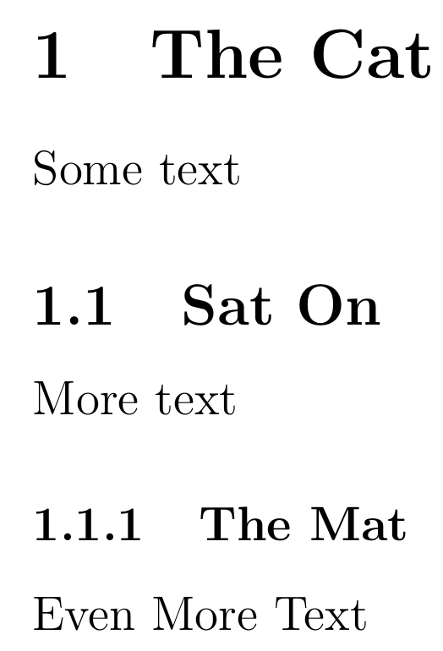
Sections
\section{The Cat}
Some text
\subsection{Sat On}
More text
\subsubsection{The Mat}
Even More Text
Notes:
You can use sections and subsections to break up and categorise your document. Using the commands “section”, “subsection” and so on allows you to specify the name of a section and then specify the content to be contained within the (sub)section.

Slide 10
Chapters
Chapters are not defined in the “article” documentclass, but are in the “book” or “report” documentclass
\chapter{A Poem}
\section{The Cat}
\subsection{Sat On}
\subsubsection{The Mat}
Notes:
You can further use chapters to break up your document into larger sections. The chapter command is an example of a command which is not available in every type of documentclass – it is available in the “report” and “book” documentclasses but not in the “article” or “slides” document class.
Different document classes may also handle chapters, sections and paragraphs differently by default, such as which (if any) begins a new page. For example, the book document class will put a chapter on the first page of a new double-page spread, which can mean a blank page is left before the start of a new chapter.
Overleaf example: https://www.overleaf.com/read/cpkybhpfdgsb

Slide 11
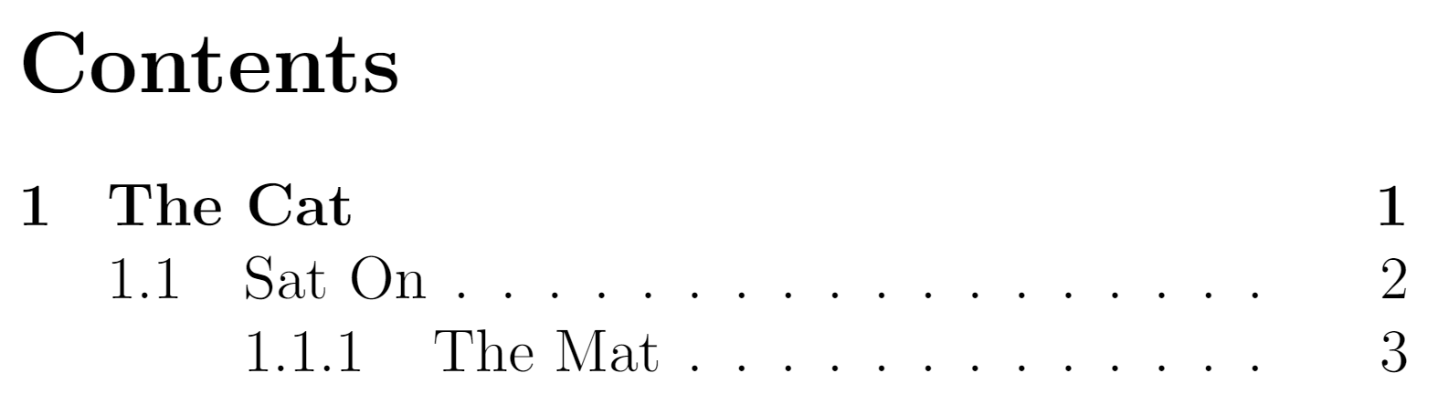
Table of Contents
\tableofcontents
Notes:
A Table of Contents may be easily inserted using the command “tableofcontents” command, which automatically detects the page numbers of chapters, sections and so on. The table of contents will be inserted at the point in the document where the command is used.
Overleaf example: https://www.overleaf.com/read/gjdnkmkdnnqd

Slide 12
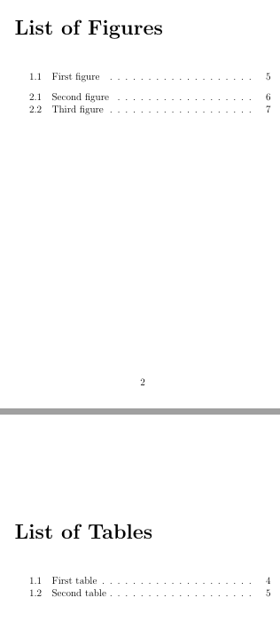
List of Tables and Figures
\listoffigures
\listoftables
Notes:
By using the “\listoffigures” and “\listoftables” commands you can insert a list of figures and list of tables respectively. Note that figures and tables are numbers are labelled “X.Y” where “X” is the chapter number and “Y” is the number of the figure/table in that chapter. The lists also slightly groups figures and tables by chapter.
Overleaf Example: https://www.overleaf.com/read/xqrwgcydcznt

Slide 13
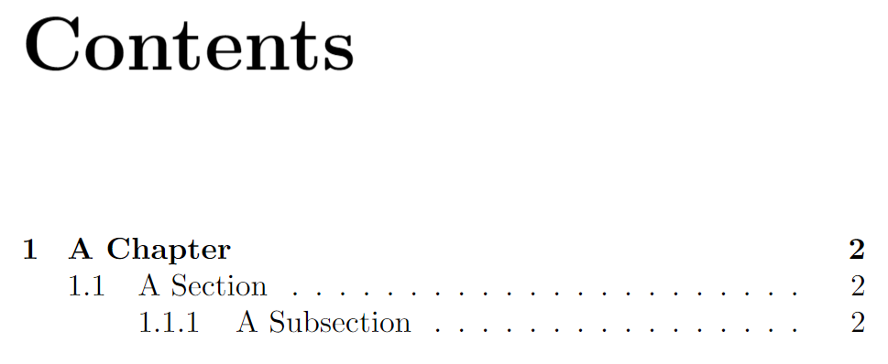
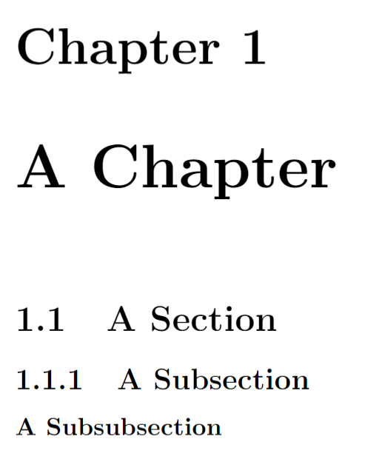
Section and Chapter Depth
\tableofcontents
\chapter{A Chapter}
\section{A Section}
\subsection{A Subsection}
\subsubsection{A Subsubsection}
Notes:
By default, LaTeX will only number sections 3 levels deep (e.g. chapter, section, subsection in the report documentclass). So, using the subsubsection command will result in an unnumbered division of the document.
Tables of contents will also omit sections more than 3 levels deep by default. This mean subsubsections also won’t appear in the Table of Contents by default.

Slide 14
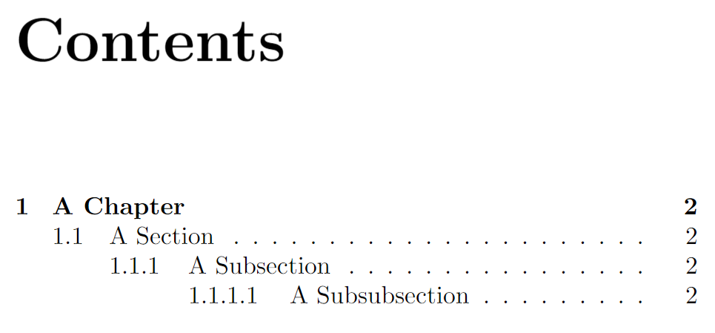
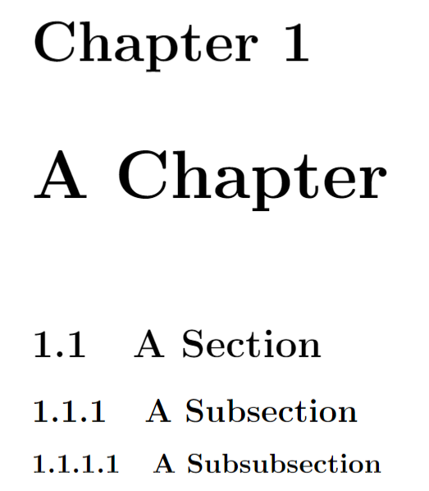
Section and Chapter Depth
Problem Sheet
Add to preamble
\setcounter {secnumdepth}{3}
\setcounter{tocdepth} {3}
Depth 0
Depth 1
Depth 2
Depth 3
Notes:
We can modify the dept that LaTeX will number sections to by modifying a value called “secnumdepth”. We ca do this by using the /setcounter command in the preamble. The default value for secnumdepth is 2 and determines the depth of the lowest-level division which will be numbered. The highest level subdivision of the document is level 0 so, by default, the highest three levels are numbered. Setting this value to 3 means the highest 4 levels are numbered. For our report class, this means subsubsections will now also be numbered.
We can also modify the “tocdepth” value which controls the maximum depth of the contents.
Overleaf example: https://www.overleaf.com/read/zbyhyfrjpmzx
Break for section 2 of Task Sheet

Slide 15
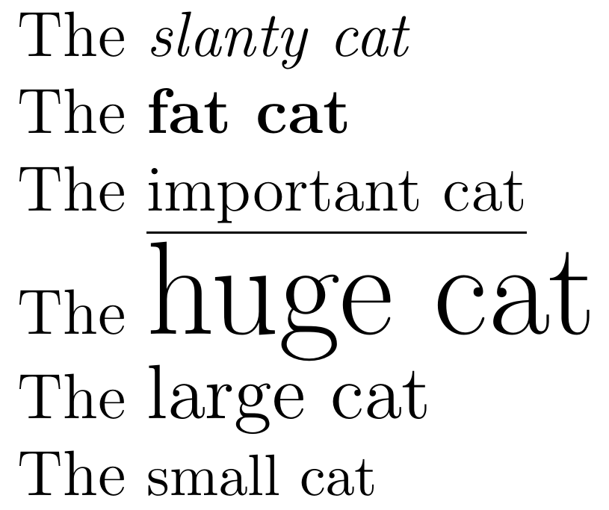
Modifying Text
Problem Sheet
The \emph{slanty cat}
The \textbf{fat cat}
The \underline{important cat}
The {\huge huge cat}
The {\large large cat}
The {\small small cat}
Notes:
Different command may be used in the middle of normally written text which modifies how the text appears in the final pdf.
The “emph” command italicises text
The “textbf” command makes a text bold
The “underline” command underlines text
The “huge” command makes text very large
The “large” command makes text large
The “small” command makes text smaller
Overleaf example: https://www.overleaf.com/read/bmvnftnttnzk
Break for section 3 of Task Sheet

Slide 16
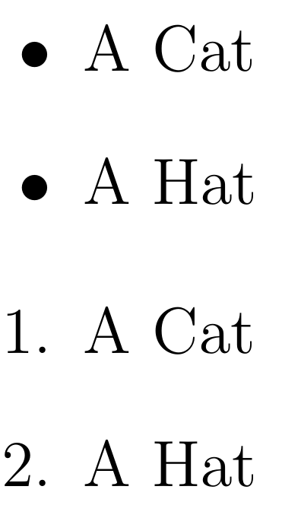
Lists
Problem Sheet
\begin{itemize}
\item A Cat
\item A Hat
\end{itemize}
\begin{enumerate}
\item A Cat
\item A Hat
\end{enumerate}
Notes:
Bulletpoint and numbered lists can be created easily in LaTeX using the “itemize” and “enumerate” commands respectively. In each case the environment is begun and ended using the “begin” and “end” commands. New items belonging to the list are then signified using the “item” command which is followed by the text associated with that item.
Overleaf example: https://www.overleaf.com/read/rvrgkkhvzpwn
Break for section 4 of Task Sheet

Slide 17
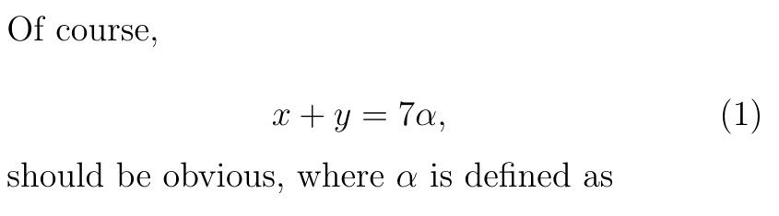
Equations
Of course,
\begin{equation}
x + y = 7 \alpha,
\end{equation}
should be obvious, where $\alpha$ is defined as
Notes:
An equation may be included utilising the equation environment which is, again, started and ended by the “begin” and “end” commands. Text in this environment is interpreted in “mathmode” which changes how the text appears, such as italicising it, and allowing the use of mathematical symbols such as the “alpha” symbol we have included with the “alpha” command. Note that LaTeX automatically numbers equations. If you want to include “mathmode” commands inline with normal text, the “dollar” symbol can be used to start and end “mathmode”.
Overleaf example: https://www.overleaf.com/8251716838wnbtxwjybszb

Slide 18
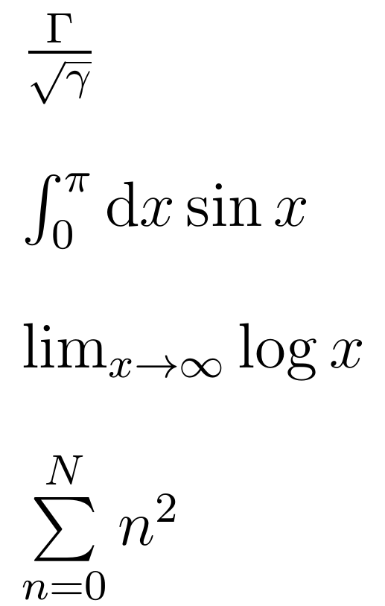
Mathmode Commands
Problem Sheet
$\frac{ \Gamma }{ \sqrt{\gamma} }$
$\int_{0}^{\pi} \textrm{d}x \sin x$
$\lim_{x \to \infty} \log x$
$\sum\limits_{n=0}^{N} n^{2}$
Notes:
Here we’ll look at a few examples of mathmode commands. For many of these, a package (often “amsmath” and “amssymb” will be required to make sure the right commands are available.
In the first command, the “frac” commands has two sets of curly brackets. The numerator is specified within the first pair of brackets and the denominator is specified in the second. We also see the square root command and the appearance of upper and lower case Greek characters.
In the second, we see the integral command. In mathmode, the underscore character, followed by a pair of curly brackets, typically defines text to appear in subscript and the “hat” character typically defines text to appear in super-script.
In the third, we see the commands for limit and log, as well as an arrow to signify “tending toward” and infinity.
In the fourth we see the summation command. Here, we have also used the “limits” command to cause the limits of the summation to appear above and below the summation symbol rather than to the right of it, as with the integration symbol. The use of the “limits” command is not compulsory, but it does look neater. There are a large number of mathmode commands and this is a quick sample of them. Google is your friend in finding specific commands.
Overleaf example: https://www.overleaf.com/read/rwkzhszhmfcd
Break for section 5 of Task Sheet

Slide 19
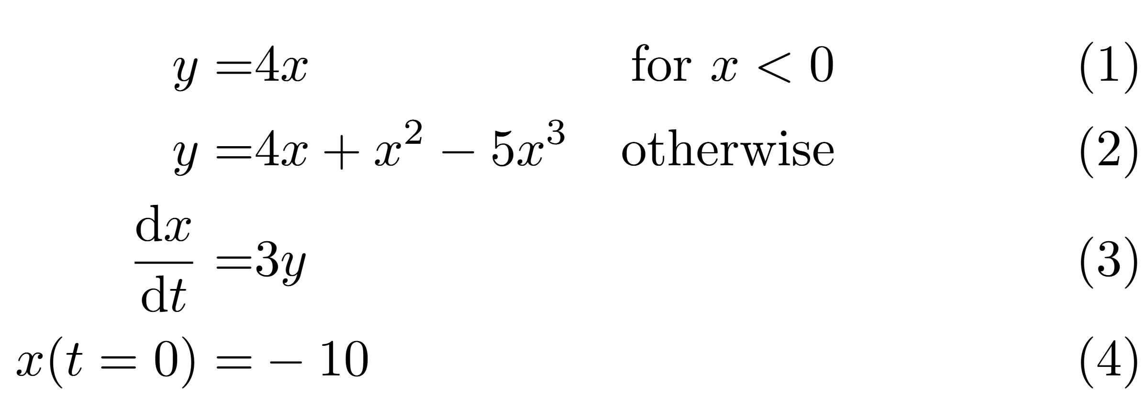
Aligning Equations
Problem Sheet
Add to preamble
\usepackage{amsmath}
\begin{alignat}{2}
y=&4x \quad & \textrm{for } x < 0\\
y=&4x+x^{2}-5x^{3} \quad & \textrm{otherwise}\\
\frac{\textrm{d}x} {\textrm{d} t}=& 3y\\
x(t=0)=&-10
\end{alignat}
Notes:
The “amsmath” package (which is a fairly standard package to use when dealing with maths) introduces the “alignat” environment. This environment allows mulriple equations to be specified in the same construct. Its contents are processed in “mathmode” and individual lines in it are treated as different equations for numbering purposes. What it also allows you to do is to align your equations. The number in curly brackets following the “\begin{alignat}” command defines how many alignment points may be used for each equation. Equations are separated with a double backslash and the alignment points are specified using the ampersand character “&”. For each equation you may use up to the maximum number of alignment points specified (here, it is 2). LaTeX will then ensure the first alignment point in each equation is vertically aligned. This can be very useful for ensuring even large blocks of equations are easy to read.
Overleaf Example: https://www.overleaf.com/read/trrzvqnfwshx
Break for sections 12 and 13 of task sheet

Slide 20
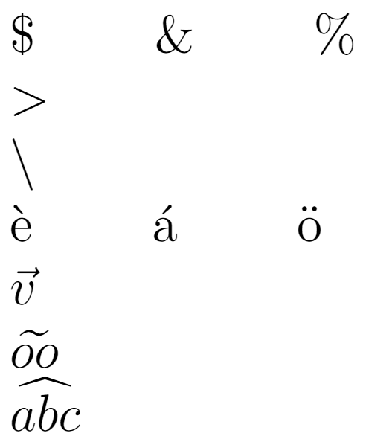
Special Characters
\$ \& \% \textgreater
\textbackslash \`{e} \’{a} \"{o}
$\vec{v}$
$\widetilde{oo}$
$\widehat{abc}$
Notes:
Some characters require special commands in LaTeX. This may be because they are characters LaTex uses for other purposes, they’re too uncommon to appear on a keyboard, they’re an accented letter or they’re a weird and wonderful mathematical construct that encompasses multiple characters. Again, the list here is completely non-exhaustive and almost anything you can think of is possible. If you don’t know how to achieve a character you can normally find it using Google pretty quickly.
Overleaf example: https://www.overleaf.com/read/jsksjfbyghkk

Slide 21
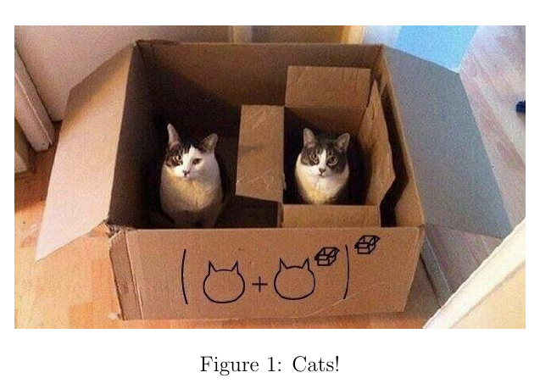
Figures
Problem Sheet
Add to preamble
Specifier | Position
h | “Here”
t | Top of page
b | Bottom of page
\usepackage{graphicx}
\begin{figure}[t]
\centering
\includegraphics[width=10cm]{Cat_Box}
\caption{Cats!}
\end{figure}
Notes:
There are several ways to include a figure in LaTeX and a wide range of options that you might use. This is one example of something you might consider. The “\begin{figure}” command tells LaTeX you’re about to define a figure. The “t” in square brackets is an optional argument which tells LaTeX where you would like to put the figure. In this case, you’re asking for the figure to be put on the top of the next page if possible. Conflicts can occur, such as when multiple figures are requested to be included at the same location. LaTeX will do its best to position figures conforming to the locations you’ve specified and also to try and reduce the amount of white space in the document. Other options to be used are “h” which asks the figure to be placed as close as possible to the text above the figure, including the middle of the page. “b” requests the image is placed at the bottom of the page.
The “centering” command lets LaTeX know that you would like the picture to be located centrally horizontally. The “includegradphics” command lets LaTeX know you would like to include a picture file with the name in the curly brackets, “Cat_Box” in this case. Note the file extension is excluded – LaTeX will search for standard image files, e.g. Cat_Box.jpg, Cat_Box.png, etc. By default, this file should be in the same directory as your .tex file. The “width” statement sets the width of the picture.
The caption command allows you to include a caption for the picture which, by default, appears under the picture.
Finally, the “\end{figure}” command ends the specification of the figure.
Overleaf example: https://www.overleaf.com/read/ymfkjjdthvwq
Break for section 6 of Task Sheet

Slide 22
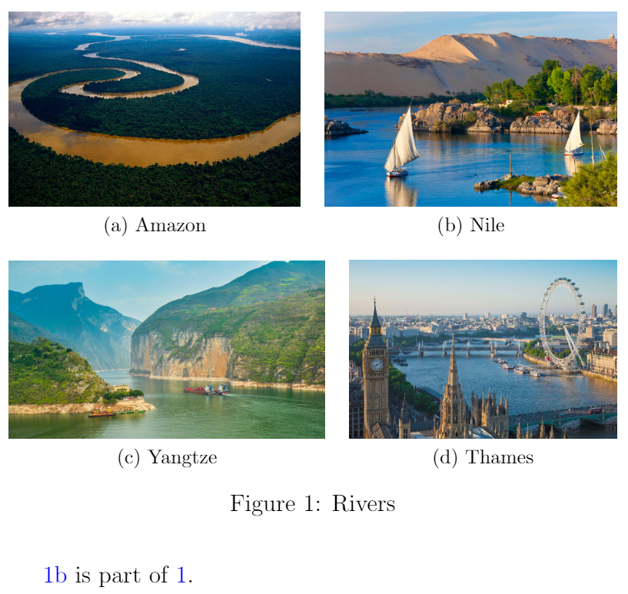
Subfigures
Add to preamble
\usepackage{subfig, graphicx}
\begin{figure}
\centering
\subfloat[Amazon]{\label{amazon}\includegraphics[width= 0.48\textwidth]{amazon_river}} \quad
\subfloat[Nile]{\label{nile}\includegraphics[width= 0.48\textwidth]{nile_river}} \\
\subfloat[Yangtze]{\label{yangtze}\includegraphics[width= 0.52\textwidth]{yangtze_river}} \quad
\subfloat[Thames]{\label{thames}\includegraphics[width= 0.44\textwidth]{thames_river}}
\caption{Rivers}\label{rivers}
\end{figure}
\ref{nile} is part of \ref{rivers}.
Notes:
In LaTeX, a subfigure, is a figure which appears as one of multiple smaller figures within a larger figure. This collection of subfigures will always be placed together as a single figure. There are a number of ways of including subfigures in your thesis.
The example I am showing you today uses the “subfig” package. Within the figure environment we use the “\subfloat” command once for each subfigure we wish to include. The “\subfloat” command is followed by the caption of the subfigure in square brackets. Then, in curly brackets, we use the “\includegraphics” command to actually include the graphics. The square brackets following the “\includegraphics command is here to specify the width of the figure in units of the width of text on the page at this point (which is referenced using the “\textwidth” command). In this case, we’ve asked for each figure to be around half of the width of the text (there’s some variation due to the aspect ratio of each image). Within the curly brackets following the “\subfloat” command we also give each individual subfigure a label so we can reference it later. Following the specification of the first and third figure we use the “\quad” command. This is a way of telling LaTeX to insert a small horizontal space between whatever came before and whatever comes next. Following the specification of the second subfigure we use a double-backslash to start a new line of subfigures within the overall figure we’re creating. This puts the third and fourth figures below the first and second.
Finally, we use the “\caption” command to give the figure that is comprised of the subfigures a caption and the “\label” command to give it a label. We see that we get a nicely spaced array of subfigures, each with their own caption, inside a larger figure which also has its own caption. We can reference any of the subfigures or the containing figure. Overleaf Example: https://www.overleaf.com/read/htdvrmwgcyvd

Slide 23
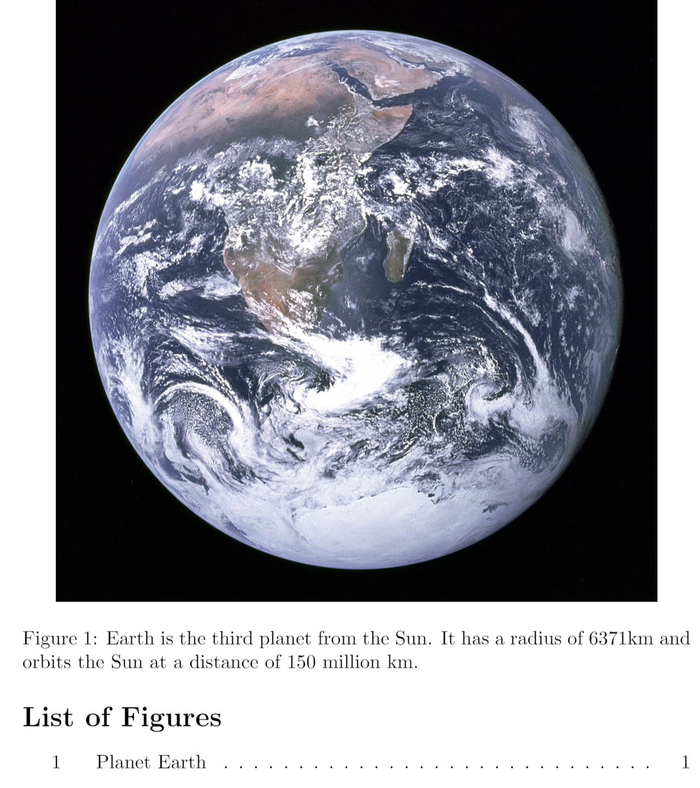
Short Captions
\listoffigures
\begin{figure}
\centering \includegraphics[width=0.9 \textwidth]{earth}
\caption[Planet Earth]{Earth is the third planet from the Sun. It has a radius of 6371km and orbits the Sun at a distance of 150 million km.}
\end{figure}
Notes:
Sometimes when writing a caption you might want to use a long caption to give a lot of information about the figure, table, etc. However, the same caption would take up a lot of space and give unnecessary detail in the list of figures or list of tables. In this case, it’s possible to specify a shorter caption to be used in the list of figures or list of tables by specifying it in square brackets after the word captions and before the full caption which is specified in curly brackets.
Because of the way the captions for subfigures are defined/used, it’s not possible or necessary to do this for subfigure captions, although it is possible to specify a short caption for a figure which contains subfigures.
Overleaf example: https://www.overleaf.com/read/kjjswpdcxsfn

Slide 24
Graphics Path
Problem Sheet
You can set where LaTeX should look for the graphics to be used in your document
Useful for separating figures for different chapters and the .tex files
The command \graphicspath {{./FOLDER1/} {./FOLDER2/}} will tell LaTeX to look in the folders named “FOLDER1” and “FOLDER2” in the directory of the .tex file
Notes:
Overleaf Example: https://www.overleaf.com/read/nwtfndvmfnpf
Break for sections 8 and 9 of Task Sheet

Slide 25
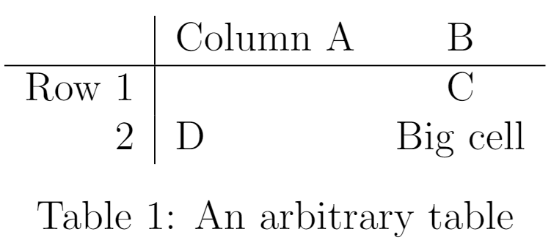
Tables
Problem Sheet
\begin{table}[h]
\centering
\begin{tabular}{ r | l c }
& Column A & B\\
\hline
Row 1 & & C \\
2 & D & Big cell
\end{tabular}
\caption{An arbitrary table}
\end{table}
Notes:
Tables can be included in LaTeX documents in a similar way to figures. The first command “\begin{table}” tells LaTeX to expect a table. In this case, we’ve chosen to include a “h” in square brackets to tell LaTeX to put the table as close as possible to the location it’s been specified in the text. Again, the “centering” causes the table to be centered horizontally on the page. Within the “tabular” environment we specify the contents of the table. In the curly brackets immediately after we begin this environment we specify the columns, their alignment and any lines between the columns. The number of these characters determines the number of columns, and which characters we use specifies the alignment. Here we have specified that we want text in the left column to be right-aligned within the column, text in the middle column to be left-aligned and text in the rightmost column to be centre-aligned within that column. The vertical line between the specification of the first and second column specifies that a vertical line is to be included in the table. If we don’t want a vertical line, as between columns 2 and 3, we don’t include a line. Next, we begin to specify the contents of the table itself. We do this row by row, with rows separated by a double backslash. It’s not required to put each line of the table on a new line of your .tex file, but it’s a good idea as it makes your file easier to read. Ampersands separate the specification of material within each column of the current row. In this case, for row 1, we include an ampersand before any text, causing the first column of row 1 to be empty. In rows 2 and 3 we specify something before the ampersand, so column 1 has entries in these rows. Between the specification of lines 1 and 2 we use the “hline” command to specify the inclusion of a horizontal line between these rows. Finally, we end the tabular and table environment with the corresponding “end” commands.
The indentation of various lines is not required, but can make the code easier to read.
Overleaf example: https://www.overleaf.com/read/dbmrcfcdhgsg
Break for section 7 of Task Sheet

Slide 26
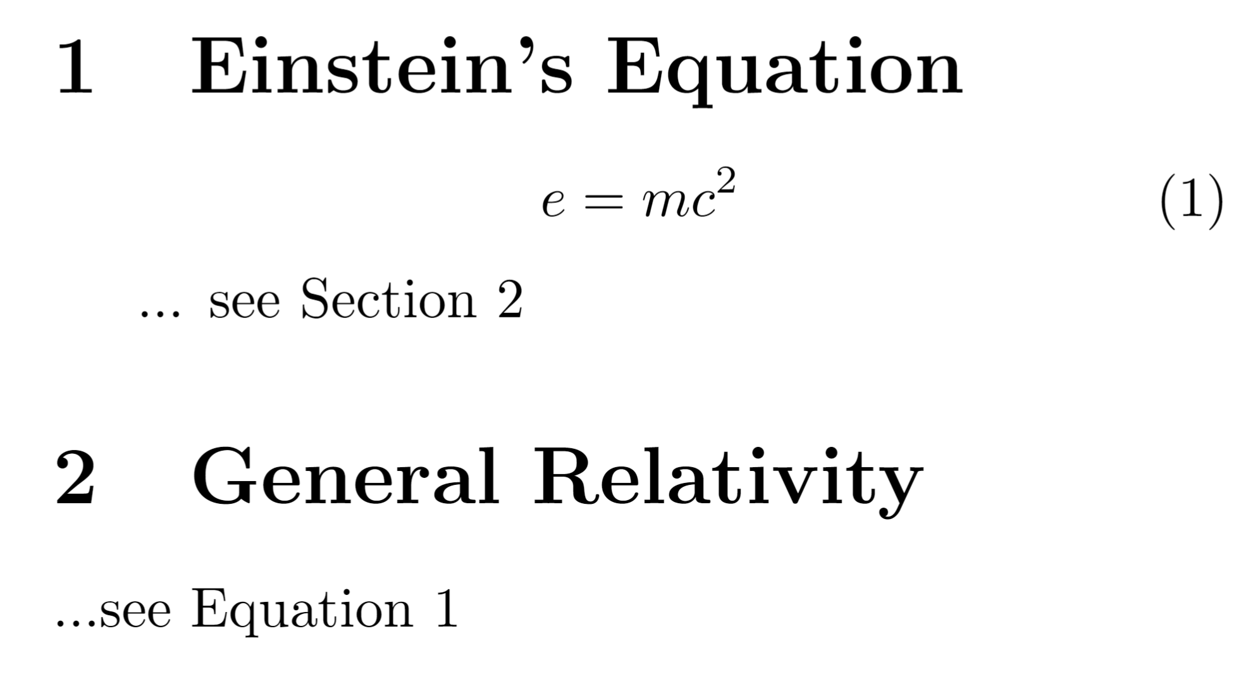
Referencing
Problem Sheet
\section{Einstein's Equation}
\begin{equation}
e = mc^{2}
\label{eq:energy_mass}
\end{equation} ... see Section \ref{sec:general_relativity}
\section{General Relativity} \label{sec:general_relativity}
...see Equation \ref{eq:energy_mass}
Notes:
LaTeX makes the management of referencing different sections and constructs within the document very easy. The first step is to label the thing you want to reference using the “label” command and specifying the keyword you want to use to reference that entity. If this command is within an equation, figure, table and so on, that is what is being given that label. If it’s not in any of these constructs, the label will be applied to the current section or chapter.
The name you label something with can be anything and will not appear anywhere in your final document, but it must be a unique label. It is wise to make the label something relevant to the construct it is labelling. You may also want to give a prefix such as “eq:” for equations, or “sec:” for sections. This makes it less likely you will accidentally create duplicate labels, and makes it easier to see what labels apply to.
The next step is to reference the entity you labelled. This is typically done using the “ref” command, which is followed by the label of the entity you wish to reference in curly brackets. In the text, this is replaced by the number of the entity referenced. For instance, if you reference the second section, the label command will be replaced by the number “2”.
Note that you can reference labelled entities that occur before or after the reference in the .tex file. If you update your tex file to include more equations, causing the number of the referenced equation to change, the number which appears in the reference will also change in your pdf when you recompile it. This means you can undertake wide-ranging restructuring of your document and references will still automatically point to the right place.
Overleaf example: https://www.overleaf.com/read/xcdwqnttrqzp

Slide 27
Splitting Your Document
Disadvantages of large .tex file
Difficult to navigate
Slow to compile
Split document into many .tex files
Notes:
Your thesis is going to be a very large document indeed. If it is all in a single .tex document it will be difficult for you to navigate. Finding chapter 2 will take time, and you’ll have better things to spend it on.
In addition, when you’re typesetting, you’ll often want to recompile your pdf multiple times to test formatting. If you have to recompile you’re entire document every time, it will be a slow process.
One strategy which solves both of these issues is to split your thesis into several .tex files. This has the side benefit that you can re-use some of these files in other documents. For example, you could use the same file containing your preamble in several LaTeX documents.

Slide 28
Splitting Your Document
main.tex
\begin{document}
\include{external_1}
\include{external_2}
\end{document}
\begin{document}
\chapter{First Chapter}
\chapter{Second Chapter}
\end{document}
=
external_1.tex
\chapter{First Chapter}
external_2.tex
\chapter{Second Chapter}
Notes:
The key to doing this is the include command. The three files on the right produce the same pdf as the single file on the right. The include command specifies the name of another .tex file to be included (don’t include the .tex extension). The files will be processed as though the commands were in a single continuous .tex file, with the exception that a new page will be inserted before the included material. Overleaf Example (unsplit document): https://www.overleaf.com/read/sqwvtspkbchs Overleaf Example (split document): https://www.overleaf.com/read/cmhxwpmfzrjj

Slide 29
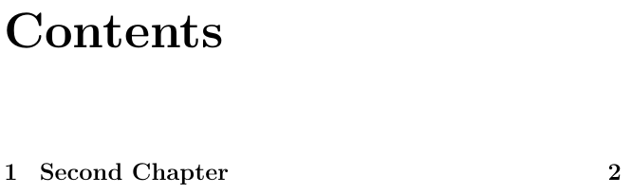
Splitting Your Document
Problem Sheet
main.tex
\includeonly{external_2}
\begin{document}
\tableofcontents
\include{external_1}
\include{external_2}
external_1.tex
\chapter{First Chapter}
external_2.tex
\chapter{Second Chapter}
Notes:
In order to cause only a subset of included files to be used when the pdf is being compiled, the “\includeonly” command can be used in the preamble. This is followed by a list of .tex files, separated by commas, which specify which included .tex files are to be used. Note that, in this example, this means the “second” chapter is included and is labelled chapter 1, but the “first” chapter is not included at all.
By excluding files in this way you can dramatically speed up the compilation of the pdf. This isn’t so much of an issue for modern computers, but you might still find it useful if you have a large and complex document.
You cannot include a .tex file that includes another .tex file. Overleaf Example: https://www.overleaf.com/read/ygsypywvjrhb
Break for section 6 of Task Sheet

Slide 30
Bibliography Management
Many documents will have a large number of references
There are many ways to include references and citations in LaTeX
Many reference management programs allow the exporting of bibliogrpahies in a .bib file
Notes:
Publications often have dozens of citations and your thesis is likely to have dozens or hundreds of references and so a good way to manage with your references is desirable. There are many ways to manage your references and many ways to personalise your citations. We’re going to run through one way to achieve a streamlined approach to referencing. Many reference managers such as EndNote, Mendeley and JabRef allow for your database of references to be exported as a “.bib” file. This is essentially a database of your references that LaTeX can interact with directly. This means you only need to enter your reference details once in your reference manager and it will feed through to your LaTeX documents including your thesis. If you combine this with the automatic population of fields in your reference manager you will never need to manually write the author of a reference again. This saves a lot of time and effort you can better spend elsewhere.

Slide 31
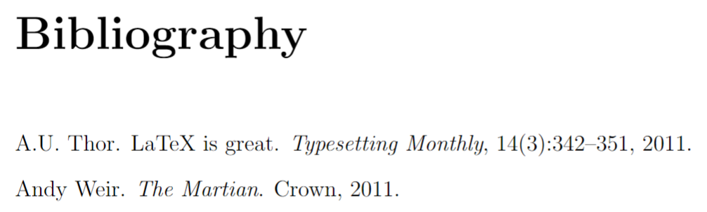
Referencing
myrefs.bib
@article{Thor_2011,
author = "A.U. Thor",
title = "{LaTeX} is Great",
year = "2011",
journal = "Typesetting Monthly",
volume = "14",
number = "3",
pages = "342--351" }
@book{Weir_2011,
author = “Andy Weir",
title = “The Martian",
year = “2011",
publisher = “Crown"}
Notes:
A “.bib” file consists of one entry for each reference. An new entry is begun with a “@” symbol and the name of the type of entry it is. Here, we have one article and one book. There are many other types such as “report”, “conference” and even “phdthesis”. See here for some more examples: https://www.verbosus.com/bibtex-style-examples.html
Within curly brackets, the first entry is a label for your reference. Following that, we then have a series of fields which define the contents of the reference. These come in the format “field name = field value” and are separated by commas. Different entries are valid for different entry types. For instance, both our entries here have “author”, “title” and “year” fields but the article has the fields “journal”, “volume”, “number” and “pages” fields whilst the book has a “publisher” field. When you compile your main .tex file, your bibliography will appear and any entries that are cited will appear in your bibliography. Entries you have not cited will not be included by default.
Overleaf example: https://www.overleaf.com/read/tfrbytxxqszf

Slide 32
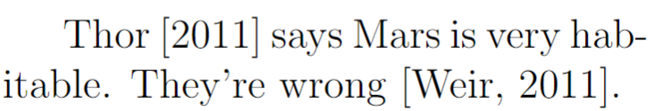
Referencing
Problem Sheet
main.tex
\usepackage{natbib}
\begin{document}
\citet {Thor_2011} is much better than its competitor \citep {Weir_2011}
\bibliographystyle{plainnat}
\bibliography{myrefs}
Notes:
In your main .tex file, you need to use the package “natbib” in your preamble. You can then cite a reference using the “citet” command with the label of the reference. This produces a reference which is “textual” in the sense that the author name is written in normal text as if it’s being read as part of the sentence. You can also use “citep” to include the entire reference within brackets. This can be useful for when you don’t intend for the reference to be read as part of the sentence, but to act as an addendum. After the main body of your text, select a bibliography style (we’ll use “plainnat” for now). Then, use the “\bibliography” command to actually insert your bibliography into your text. This is followed by the name of your “.bib” file in curly brackets (do not include the “.bib” extension here).
Overleaf example: https://www.overleaf.com/read/tfrbytxxqszf

Slide 33
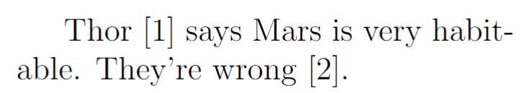
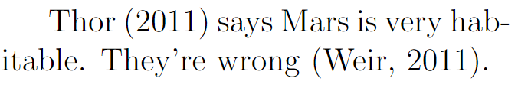
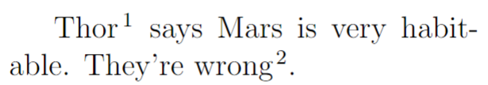
Personalising References
\usepackage[numbers]{natbib}
\usepackage[round]{natbib}
\usepackage[super]{natbib}
Notes:
There are a number of different ways you can personalise your references. Here we’ll look at different options you can use with the natbib package which will alter how your reference appear. Using the “numbers” option will cause you to use numerical references instead of textual references. “round” will cause your references to use round brackets instead of square brackets. “super” causes your citations to appear in super-script, similar to a footnote.
Overleaf Example (numbers): https://www.overleaf.com/read/nyhjxjvhvqpk
Overleaf Example (round): https://www.overleaf.com/read/dfvnydjfjpfb
Overleaf Example (super): https://www.overleaf.com/read/zgtgtvqhcvfc

Slide 34
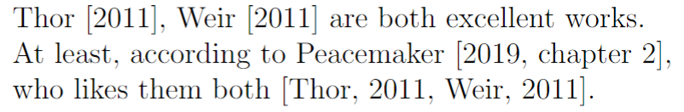
More Ways to Cite
\citet {Thor_2011, Weir 2011} are both excellent works. At least, according to \citet [chapter 2] {Peace_2019}, who likes them both \citep {Thor_2011, Weir_2011}.
Notes:
There are more ways you can make a citation. You can include multiple citations within a single “citet” or “citep” command, separating them with commas. You can also provide additional details, such a referencing a chapter number by including them in square brackets between the “cite” command and the curly brackets.
Overleaf Example: https://www.overleaf.com/read/cqbhnvfsfzpp

Slide 35
Bibliography Gotchas
Problem Sheet
Capitalisation
{NASA}
Accents
Ren\’{e}e
Multiple Author names
author = “Ernest Hemingway, R.L. Stine, J.R.R. Tolkien”
author = “Hemingway, Ernest; Stine, R.L.; Tolkien, J.R.R”
author = “Ernest Hemingway and R.L. Stine and J.R.R. Tolkien”
Notes:
There are a few “gotchas” regarding references and bibliographies. These are things that you might expect to work one way, but they actually work a different way.
The first is capitalisation. In titles and names, LaTeX will use it’s own rules for capitalisation. In titles, the default is to make everything lower-case. This can provide a big problem, particularly for acronyms. However, you can force LaTeX to preserve your original capitalisation by placing the phrase in curly brackets. If you include accented letters in your bibliography, this will not result in an accent appearing in your bibliography as LaTeX doesn’t know how to parse the character. Instead, you need to include the LaTeX code for accented character in your “.bib” file.
There a couple of ways of entering multiple author names. You might think that separating author names by commas will work, but this will not produce the desired effect. This is partially because commas are often used between a surname and first names in author specifications. Instead, you can separate names with “and” or with semi-colons.
Break for section 11 of Task Sheet

Slide 36
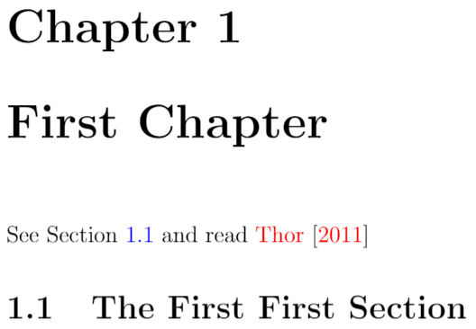
Hyperlinks
Problem Sheet
Add to preamble
\usepackage[colorlinks=true, linkcolor=blue, citecolor=red]{hyperref}
\chapter{First Chapter}
See Section \ref{first_first_section} and read \citet{Thor_2011}.
\section{The First First Section}\label{first_first_section}
Notes:
Normally, references will produce the correct number for the referenced section, figure, etc in a normal text form. However, we can turn them into active hyperlinks that will allow a user to jump to the relevant point in your document by clicking on the reference. You can modify your document so all references are turned into hyperlinks in this way using the “hyperref” package. This package has a number of options you can use to customise your references. I strongly recommend setting the “colorlinks” option to “true”, feel free to experiment with what it looks like when you don’t do this. You can also set the colour of your links using the “linkcolor” option and colour of your citations using the “citecolor” option. Putting hyperlinks into your thesis is a very good idea as it helps navigation of what is a very large document. Overleaf Example: https://www.overleaf.com/read/tzdbtmdmtfhd
Break for Section 7 of Task sheet

Slide 37
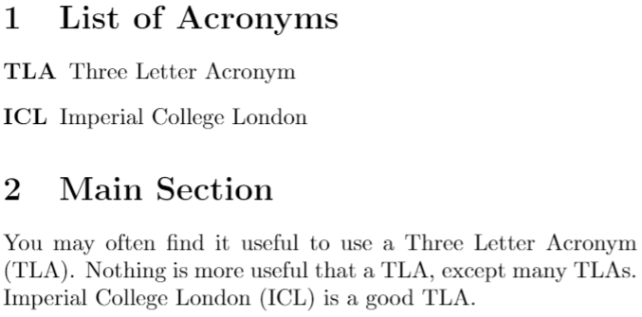
Acronyms
Add to preamble
\usepackage{acronym}
\section{List of Acronyms}
\begin{acronym}
\acro{TLA}{Three Letter Acronym}
\acro{ICL}{Imperial College London}
\end{acronym}
\section{Main Section}
You may often find it useful to use a \ac{TLA}. Nothing is more useful that a \ac{TLA}, except many \ac{TLA}s. \ac{ICL} is a good \ac{TLA}.
Notes:
The acronym package provides a useful way to deal with acronyms in your document. Inside the “acronym” environment, you can use the “\acro” command to define an acronym. This command is followed by two sets of curly brackets. The first contains the abbreviated version of the acronym. The second contains the expanded version of the acronym. Defining acronyms in this way creates a list of acronyms at the location of the “acronym” environment in your pdf. It’s also possible to define acronyms using the “\acrodef” command in the preamble to avoid a list of acronyms if desired. In the main text you may use the commands “\ac” and “\acp” to insert the acronym or the plural of the acronym respectively. The first time an acronym is used this way both the expanded and contracted version of the acronym will be inserted. In subsequent cases only the contracted version is used. Overleaf Example: https://www.overleaf.com/read/jqsvjjpgjzjp

Slide 38
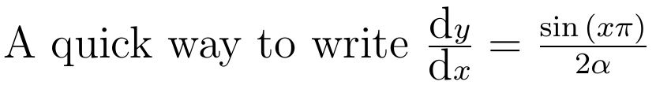
Custom Commands
Problem Sheet
Add to preamble
\newcommand{\hardmaths} {\frac{\sin{(x\pi)}} {2\alpha}}
\newcommand{\diff}[2] {\frac{\textrm{d}{#1}} {\textrm{d}{#2}}}
A quick way to write $\diff{y}{x}=\hardmaths$
Notes:
In your preamble you can use the “\newcommand” command to define a new command. This is a little like defining a macro or a function in other programs or languages. “\newcommand” is followed by the name of the command in curly brackets. This is followed by the number of arguments the command (if there are arguments to the command). This is followed by the text that will be used in the body of the .tex file where the command is used. In this definition, if “#X” is included within curly brackets, this will insert the Xth argument in the text used.
To use the command in the document, you can use “\COMMAND_NAME” to invoke the command. This is followed by a the arguments of the command, each in their own set of curly brackets. This can be very useful for automating text you use repeatedly that is the same or similar every time but is long-winded to write out. It’s also possible to redefine existing commands or define new environments, but this won’t be covered in this course.
Overleaf Example: https://www.overleaf.com/read/hxttrgqqvpyp
Break for section 10 of Task Sheet

Slide 39
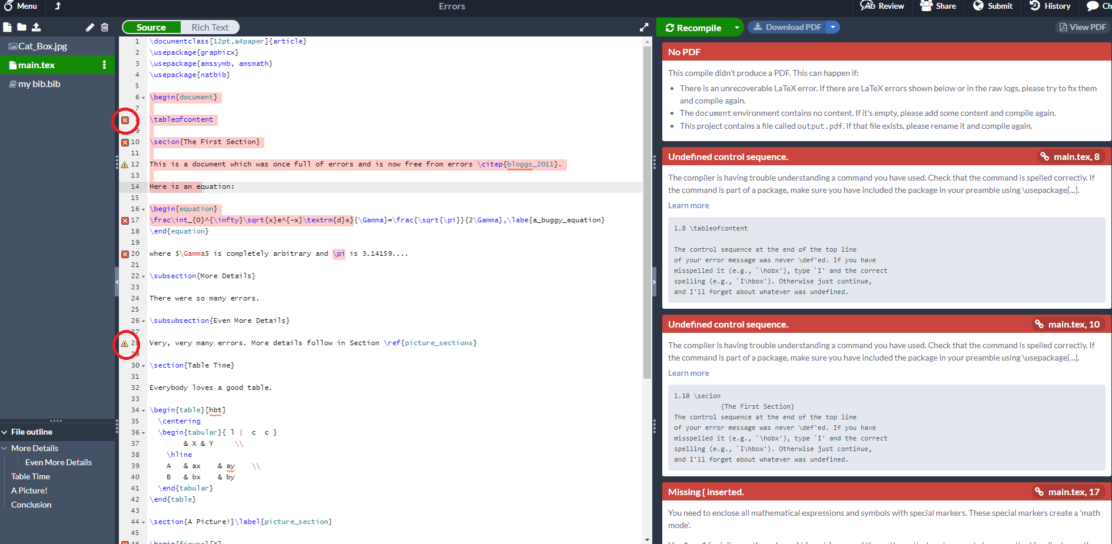
LaTeX Errors
Problem Sheet
Notes:
As LaTeX runs, it keeps a log of what it’s doing. Most of these messages can be safely ignored. However, one class of message that is very helpful is the error message. Overleaf, like all LaTeX compilers will keep a log of all messages is generated. When LaTeX hits a section of code with an error, it will typically generate a number of useful messages and then stop progressing further. If you carefully read the messages, they often lead you straight to the source of the error.
LaTeX will normally tell you what the error is and on what line of the file the error occurred. Overleaf takes this a step further and shows you a small error symbol next to the line number. You can hover over this to read the error message. The full message log can be read by clicking the “Log and Output Files” button next to the “Recompile” button just above where the pdf is normally displayed. When you receive an error from LaTeX (in Overleaf, or from whatever LaTeX compiler you’re using), read the error message, edit your tex file to correct the error and recompile the pdf. Hopefully you will have fixed the error. Otherwise, you’ll receive another error message. LaTeX will also give you warnings, telling you if there was something it wasn’t sure what to do with, but was able to complete the document in any case. It’s also a good idea to look through the entire pdf by eye for anywhere that you’ve given a valid instruction, but one that has produced a different result to what you wanted.
When tackling errors, it’s often worth correcting the earliest error first – sometimes doing so will fix subsequent errors.
Latex example: https://www.overleaf.com/read/gnzphcnqgfvf
Break for section 10 of Task Sheet.

Slide 40
Journal Submission
Journal documentclasses
Submit your source files
Perfection not required
Notes:
If you’re working on a document to submit to a journal, there are a number of things to bear in mind. Many journals have custom documentclasses which they make available and you can chose to use when submitting. Some journals might require you to use their documentclass when submitting. In many cases you can submit your LaTeX source files to the journal as well. This aids the typesetters at the journal in working on your document. For many journals, typsetters will alter your script substantially to make sure it fits the standards and style of the journal. This means that you don’t need to make your document look perfect when you submit it. You need it to be easily legible for the reviewers and editors to read, but spending days tweaking fine details might not be a good use of your time. Check the process and requirements of the journal you’re submitting to so you fulfil all their requirements but don’t put in effort that will ultimately be wasted.

Slide 41
Useful Online Tools
Google
Stack Exchange
Overleaf
Wikibook
Table Maker
Equation Editor
Mathpix
Detexify
Notes:
If you want to do something in LaTeX but don’t know how, the first thing to do is to Google it. Somebody has almost certainly had your problem/desire before and you can copy their solution most of the time. On many occasions, you’ll find the answer of stackexchange. As well as being a useful environment to develop and run LaTeX, Overleaf has an extensive library of documentation on LaTeX’s functions. There’s also a very good wikibook that contains a good description of the functionality of LaTeX. There’s also a good table maker which allows you to define tables in a more natural and graphical way and have it return the equivalent LaTeX code. There’s also an equation editor which allows you to define equations in a more graphical fashion and have it return the equivalent LaTeX code. Mathpix can look at images of equations, tables, etc and produce equivalent LaTeX code. Detexify can use machine learning to identify which LaTeX would render a symbol you have drawn.

Slide 42

Please take 3 minutes to complete the evaluation
Once you’ve completed this course, please provide feedback
The link is https://tinyurl.com/feedback-rcds
You should also have received an email with this link
This helps us improve the class for future students

Slide 43
Thank you
Presentation Title
DD/MM/YYYY

